Slide 1


01
BIT COHORT3
FRONT END
WEB. DEV.

Slide 2

TEAM MEMBERS
02
Ariwodo, Chinedum Christian
08103375169
christianchinedumariwodo@gmail.com
==================
Emediong Mfon Okon
09012610677
okonemdiong2020@gmail.com
==================
Idungafa isaac Aniekan
08033567068
idungafaisaac@gmail.com
Anita Joseph
08123410045
ap5232367@gmail.com
================
Ubong Felix Udo
09015238459
udoubong416@gmail.com

Slide 3
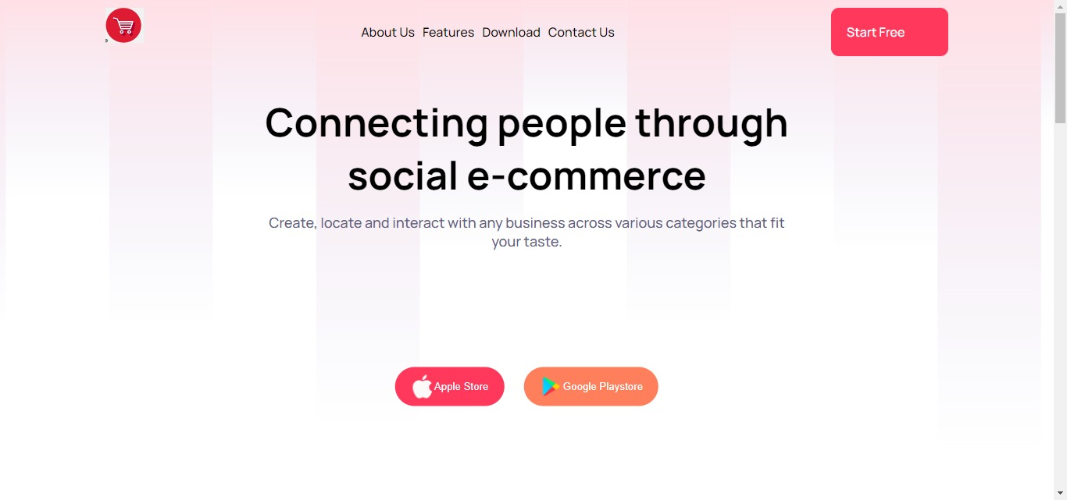

03
An E-Commerce Site
LANDING
PAGE

Slide 4
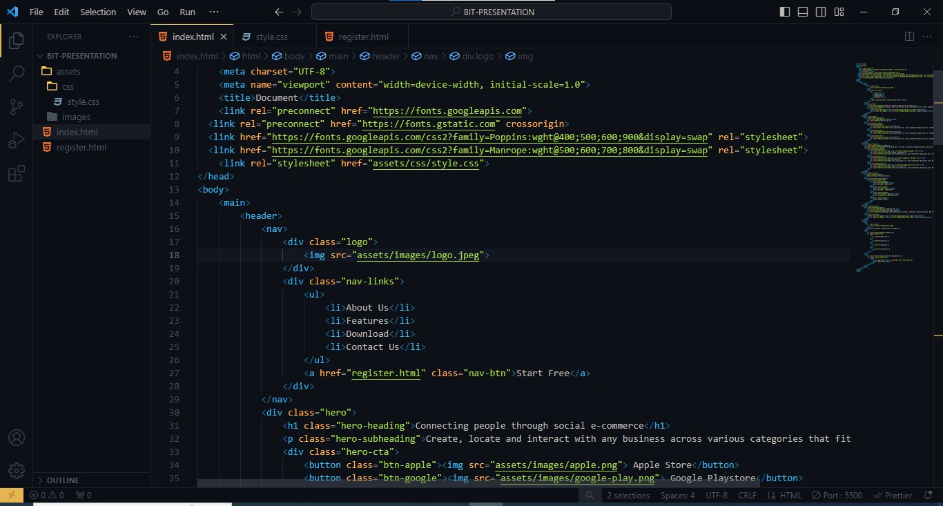
04
CODE BASE
Comprise basically of HTML and CSS

Slide 5
05
THANK YOU

